Slide 1
A Fast Algorithm for Particle Simulation

Slide 2

Traditional Method
1
4
1
4
1
4
1
4
6
6
6
…
6
3
3
3
3
2
2
2
2
5
7
N
5
7
N
5
N
5
7
N
7
N work | N work | N work |  | N work
N$×$N work

Slide 3


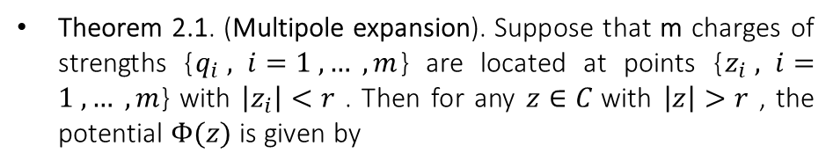



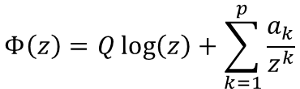












Fast Algorithm
•
• | • | •
• | • | •
• | • | •
1
1
4
$$y_{1}$$
4
$$y_{2}$$
$$y_{3}$$
6
6
3
3
2
$$x_{0}$$
$$Φ(x_{0}\text{)}$$
2
$$x_{0}$$
$$y_{4}$$
$$y_{5}$$
5
N
5
$$Φ(y_{j}\text{)}$$
7
N
$$y_{6}$$
$$y_{7}$$
7
$$y_{8}$$
1. Computation of the coefficients of $Φ(x_{0}$) due to the charges about $x_{0}$.
2. Evaluation the coefficients of $Φ(x_{0}$) at all points $y_{j}$.
mp work | np work
mp $+$np work
Theorem 2.1. (Multipole expansion). Suppose that m charges of strengths {$q_{i} , i=1 , … , m$} are located at points {$z_{i} , i=1 , … , m$} with $\left|z_{i}\right|<r$ . Then for any $z∈C$with $\left|z\right|>r$ , the potential $Φ(z)$ is given by
$$Φ\left(z\right)=Q\log\left(z\right)+\sum_{k=1}^{p}{\frac{a_{k}}{z^{k}}}$$
$$Q=\sum_{i=1}^{m}{q_{i}}$$
$$a_{k}=\sum_{i=1}^{m}{\frac{−q_{i} {z_{i}}^{k}}{k}}$$
$$p≈−\log_{2}{ε}$$
$ε$is relative precision

Slide 4
Traditional Method and Fast Algorithm
Fast Algorithm
the order of$O\left(n+m\right)$
the order of 𝑂(𝑛+𝑚)
Traditional Method
the order of$O\left(nm\right)$
the order of 𝑂(𝑛𝑚)
For a system of n particles, the amount of work that is needed to evaluate potential at m point

Slide 5
The strategy of fast algorithm
Clustering particles
Interactions with particles which are nearby
Interactions with clusters which are sufficiently far away

Slide 6
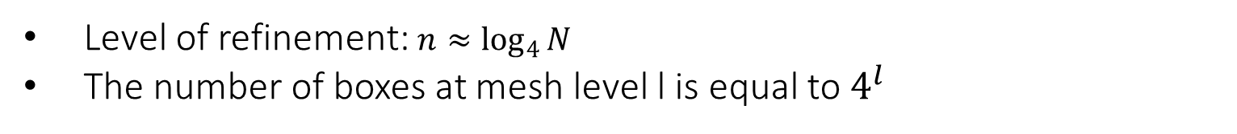
Computational Box
Level 0
Level 1
Level 2
Level 3
Level of refinement: $n≈\log_{4}{N}$
The number of boxes at mesh level l is equal to $4^{l}$

Slide 7
Computational Box
 |  |  |  |  | ibox
interaction list of ibox
Interaction list:
Children of the nearest neighbors of ibox’s parent which are well separated from ibox

Slide 8

Notation used
p-term multipole expansion
$$Φ_{l,i}$$
the p-term multipole expansion (about the box center) of the potential field created by the particles contained inside box i at level l.
Box i

Slide 9

Notation used
interaction list of ibox
p-term expansion
$$Ψ_{l,i}$$
the p-term expansion about the center of ibox at level l, describing the potential field due to all particles inside the interaction list of ibox.
center

Slide 10

Notation used
interaction list of ibox
p-term local expansion
$${\tilde{Ψ}}_{l,i}$$
the p-term local expansion about the center of ibox at level l, describing the potential field due to all particles inside the interaction list of ibox and ibox’s parent.
center
interaction list of ibox’s parent

Slide 11
Algorithm
Step 1.
Form $Φ_{finest mesh, ibox}(box center)$ due to particles in each child box
Form Φ_(𝑓𝑖𝑛𝑒𝑠𝑡 𝑚𝑒𝑠ℎ, 𝑖𝑏𝑜𝑥) (𝑏𝑜𝑥 𝑐𝑒𝑛𝑡𝑒𝑟) due to particles in each child box
Step 2.
Form $Φ_{coarser mesh, ibox}(box center)$ due to particles in each child box
Form Φ_(𝑐𝑜𝑎𝑟𝑠𝑒𝑟 𝑚𝑒𝑠ℎ, 𝑖𝑏𝑜𝑥) (𝑏𝑜𝑥 𝑐𝑒𝑛𝑡𝑒𝑟) due to particles in each child box
For every particle in box ibox, add direct and far field terms together
Step 3.
Form a local expansion about the center of each box at coarser mesh $l≤n−1$
Form a local expansion about the center of each box at coarser mesh 𝑙≤𝑛−1
Step 4.
Form a local expansion at finest mesh level $l=n$
Form a local expansion at finest mesh level 𝑙=𝑛
Step 5.
Evaluate local expansion ${\tilde{Ψ}}_{n, ibox}(z_{j})$ at particle positions
Evaluate local expansion Ψ ̃_(𝑛, 𝑖𝑏𝑜𝑥) (𝑧_𝑗) at particle positions
Step 6.
Compute potential due to nearest neighbors directly
Step 7.
Form a p-term multipole expansion $Φ_{finest mesh, ibox}$ , by using Theorem 2.1.
Form a p-term multipole expansion Φ_(𝑓𝑖𝑛𝑒𝑠𝑡 𝑚𝑒𝑠ℎ, 𝑖𝑏𝑜𝑥) , by using Theorem 2.1.
Form a p-term multipole expansion $Φ_{coarser mesh, ibox}$ , by using Lemma 2.3 to shift the center of each child box’s expansion to the current box center and adding them together.
Form a p-term multipole expansion Φ_(𝑐𝑜𝑎𝑟𝑠𝑒𝑟 𝑚𝑒𝑠ℎ, 𝑖𝑏𝑜𝑥) , by using Lemma 2.3 to shift the center of each child box’s expansion to the current box center and adding them together.
Form $Ψ_{l,ibox}$ by using Lemma 2.4 to convert multipole expansion $Φ_{l, interaction list}$ to local expansion, adding these expansions together.
Form Ψ_(𝑙,𝑖𝑏𝑜𝑥) by using Lemma 2.4 to convert multipole expansion Φ_(𝑙, 𝑖𝑛𝑡𝑒𝑟𝑎𝑐𝑡𝑖𝑜𝑛 𝑙𝑖𝑠𝑡) to local expansion, adding these expansions together.
Adding result to ${\tilde{Ψ}}_{l, ibox}$
Adding result to Ψ ̃_(𝑙, 𝑖𝑏𝑜𝑥)
Form${\tilde{Ψ}}_{l+1, ibox^{′}s children}$by using lemma 2.5 to expand $Ψ_{l,ibox}$ about the children’s box centers.
Form𝛹 ̃_(𝑙+1, 𝑖𝑏𝑜𝑥^′ 𝑠 𝑐ℎ𝑖𝑙𝑑𝑟𝑒𝑛)by using lemma 2.5 to expand 𝛹_(𝑙,𝑖𝑏𝑜𝑥) about the children’s box centers.
Form $Ψ_{l,ibox}$ by using Lemma 2.4 to convert multipole expansion $Φ_{l, interaction list}$ to local expansion, adding these expansions together.
Form Ψ_(𝑙,𝑖𝑏𝑜𝑥) by using Lemma 2.4 to convert multipole expansion Φ_(𝑙, 𝑖𝑛𝑡𝑒𝑟𝑎𝑐𝑡𝑖𝑜𝑛 𝑙𝑖𝑠𝑡) to local expansion, adding these expansions together.
Adding result to ${\tilde{Ψ}}_{l, ibox}$
Adding result to Ψ ̃_(𝑙, 𝑖𝑏𝑜𝑥)

Slide 12


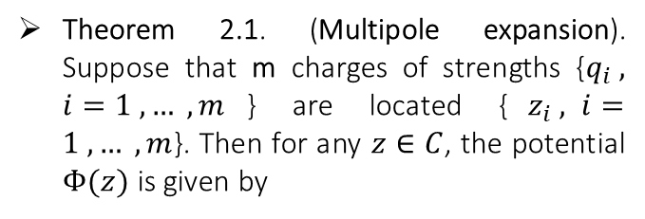
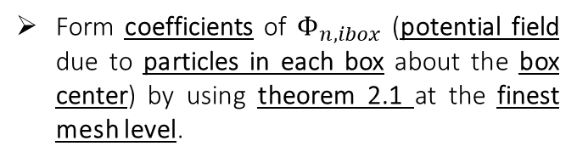




Algorithm
· |  | · | · |  |  | ·
· |  | · |  |  | · |  | ·
 | · |  |  | · | ·
· |  |  | · |  | ·
 |  | · |  |  | · |  | ·
· |  |  | · |  |  |  | ·
· |  |  | · |  | · | ·
Step 1
Form coefficients of $Φ_{n,ibox}$ (potential field due to particles in each box about the box center) by using theorem 2.1 at the finest mesh level.
$$Z_{i}=Z_{cg}−Z_{ig}$$
Local origin
Box center
$$Z_{i}$$
Theorem 2.1. (Multipole expansion). Suppose that m charges of strengths {$q_{i} , i=1 , … , m$} are located {$z_{i} , i=1 , … , m$}. Then for any $z∈C$, the potential $Φ(z)$ is given by
$$Z_{cg}$$
$$Z_{ig}$$
Form these coefficients at the finest mesh level
$$Φ\left(z\right)=Q\log\left(z\right)+\sum_{k=1}^{p}{\frac{a_{k}}{z^{k}}}$$
$$Q=\sum_{i=1}^{m}{q_{i}}$$
$$a_{k}=\sum_{i=1}^{m}{\frac{−q_{i} {z_{i}}^{k}}{k}}$$
Global origin

Slide 13


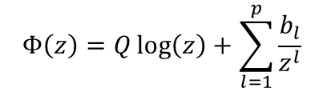

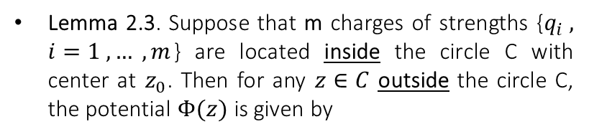
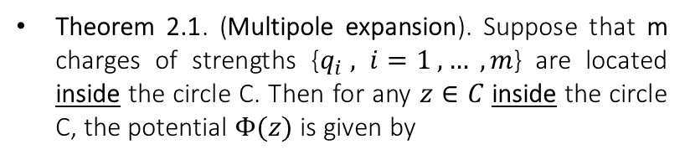


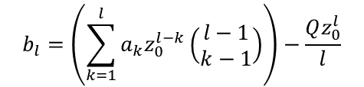
Lemma 2.3.
Calculating the potential due to a set of m charges about a point inside the circle (by using the location of each charge)
Calculating the potential due to a set of m charges about a point outside the circle (by using the center of the circle instead of the location of each charge)
•
•
c
1
c
1
2
2
m
N
$$z_{0}$$
3
3
7
$$z$$
7
4
4
6
5
6
5
$$z$$
Theorem 2.1. (Multipole expansion). Suppose that m charges of strengths {$q_{i} , i=1 , … , m$} are located inside the circle C. Then for any $z∈C$ inside the circle C, the potential $Φ(z)$ is given by
Lemma 2.3. Suppose that m charges of strengths {$q_{i} , i=1 , … , m$} are located inside the circle C with center at $z_{0}$. Then for any $z∈C$ outside the circle C, the potential $Φ(z)$ is given by
$$Φ\left(z\right)=Q\log\left(z\right)+\sum_{k=1}^{p}{\frac{a_{k}}{z^{k}}}$$
$$Q=\sum_{i=1}^{m}{q_{i}}$$
$$a_{k}=\sum_{i=1}^{m}{\frac{−q_{i} {z_{i}}^{k}}{k}}$$
$$Φ\left(z\right)=Q\log\left(z\right)+\sum_{l=1}^{p}{\frac{b_{l}}{z^{l}}}$$
$$b_{l}=\left(\sum_{k=1}^{l}{a_{k}z_{0}^{l−k}}\left(\begin{matrix}l−1 \\ k−1\end{matrix}\right)\right)−\frac{Qz_{0}^{l}}{l}$$

Slide 14




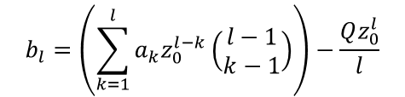
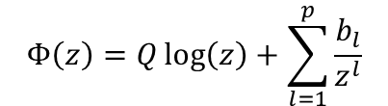

$$l=3$$
Algorithm
· |  | · | · |  |  | ·
· |  | · |  |  | · |  | ·
 | · |  |  | · | ·
· |  |  | · |  | ·
 |  | · |  |  | · |  | ·
· |  |  | · |  |  |  | ·
· |  |  | · |  | · | ·
Step 2
Form $Φ_{l,ibox}$ ($l=0,…,n−1$) by using lemma 2.3 to shift the center of each child box’s expansion to the current box center and adding them together.
$$Z=Z_{cg}(k−1)−Z_{cg}$$
$$Z$$
$$Z_{cg}(k−1)$$
$$Φ\left(z\right)=Q\log\left(z\right)+\sum_{l=1}^{p}{\frac{b_{l}}{z^{l}}}$$
$$Z_{cg}(k)$$
$$b_{l}=\left(\sum_{k=1}^{l}{a_{k}z_{0}^{l−k}}\left(\begin{matrix}l−1 \\ k−1\end{matrix}\right)\right)−\frac{Qz_{0}^{l}}{l}$$
coarser mesh level
Finest mesh level
Global origin

Slide 15
$$l=1$$
$$l=2$$
· |  | · | · |  |  | ·
· |  | · |  |  | · |  | ·
 | · |  |  | · | ·
· |  |  | · |  | ·
 |  | · |  |  | · |  | ·
· |  |  | · |  |  |  | ·
· |  |  | · |  | · | ·
· |  | · | · |  |  | ·
· |  | · |  |  | · |  | ·
 | · |  |  | · | ·
· |  |  | · |  | ·
 |  | · |  |  | · |  | ·
· |  |  | · |  |  |  | ·
· |  |  | · |  | · | ·

Slide 16

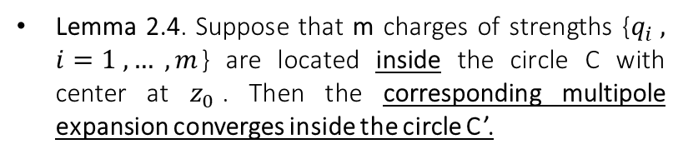


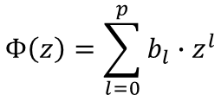
Lemma 2.4.
Multipole expansion
•
Local expansion
•
1
c
1
C
2
2
m
N
3
$$z_{0}$$
3
7
$$z$$
7
4
•
C’
4
6
5
6
5
Calculating the potential due to a set of m charges about a point inside the circle (by using the location of each charge)
The potential due to a set of m charges converges inside a area (inside the circle C’)
$$0$$
Theorem 2.1. (Multipole expansion). Suppose that m charges of strengths {$q_{i} , i=1 , … , m$} are located inside the circle C. Then for any $z∈C$ inside the circle C, the potential $Φ(z)$ is given by
Lemma 2.4. Suppose that m charges of strengths {$q_{i} , i=1 , … , m$} are located inside the circle C with center at $z_{0}$. Then the corresponding multipole expansion converges inside the circle C’.
$$b_{0}=\sum_{k=1}^{p}{\frac{a_{k}}{z_{0}^{k}}{\left(−1\right)}^{k}+Q\log\left(−z\right)}$$
$$Φ\left(z\right)=Q\log\left(z\right)+\sum_{k=1}^{p}{\frac{a_{k}}{z^{k}}}$$
$$Q=\sum_{i=1}^{m}{q_{i}}$$
$$a_{k}=\sum_{i=1}^{m}{\frac{−q_{i} {z_{i}}^{k}}{k}}$$
$$Φ\left(z\right)=\sum_{l=0}^{p}{b_{l}∙z^{l}}$$
$$b_{l}=\left(\frac{1}{z_{0}^{l}}\sum_{k=1}^{p}{\frac{a_{k}}{z_{0}^{k}}{\left(\begin{matrix}l+k−1 \\ k−1\end{matrix}\right)\left(−1\right)}^{k}}\right)−\frac{Q}{l∙z_{0}^{l}}$$

Slide 17
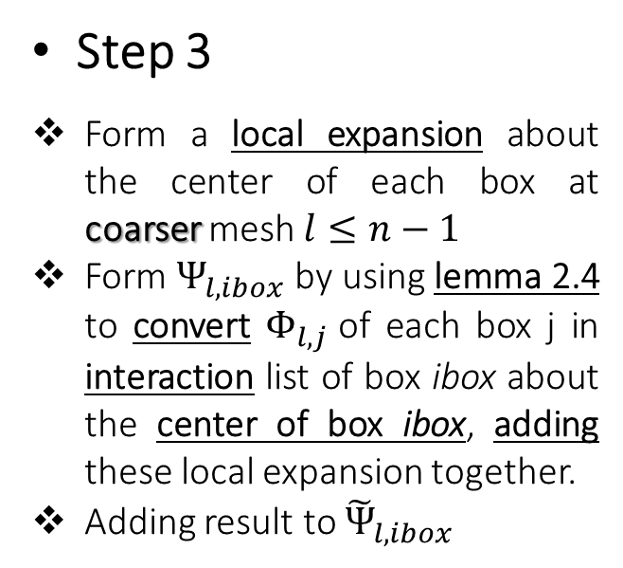
Algorithm
• | • |  | ·
• | •
• | • | • | •
• | • | • | •
ibox
Step 3
Form a local expansion about the center of each box at coarser mesh $l≤n−1$
Form $Ψ_{l,ibox}$ by using lemma 2.4 to convert $Φ_{l,j}$of each box j in interaction list of box ibox about the center of box ibox, adding these local expansion together.
Adding result to ${\tilde{Ψ}}_{l, ibox}$
Global origin

Slide 18
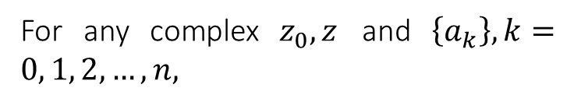
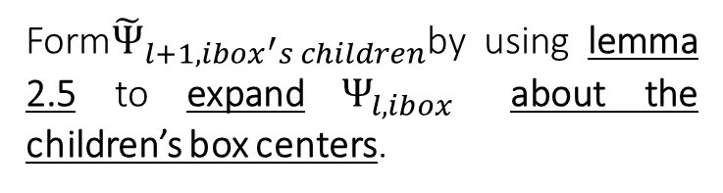
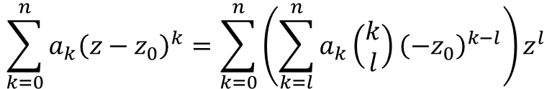
Algorithm
ibox’s children
• | • |  | • | •
 |  |  | • | •
• | •
• | • | • | •
• | • | • | •
ibox
Step 3
Form${\tilde{Ψ}}_{l+1, ibox^{′}s children}$by using lemma 2.5 to expand $Ψ_{l,ibox}$ about the children’s box centers.
Lemma 2.5
For any complex $z_{0},z$ and $\left\{a_{k}\right\}, k=0, 1, 2, …, n,$
$$\sum_{k=0}^{n}{{a_{k}\left(z−z_{0}\right)}^{k}=\sum_{k=0}^{n}{\left(\sum_{k=l}^{n}{a_{k}\left(\begin{matrix}k \\ l\end{matrix}\right){\left(−z_{0}\right)}^{k−l}}\right)z^{l}}}$$

Slide 19
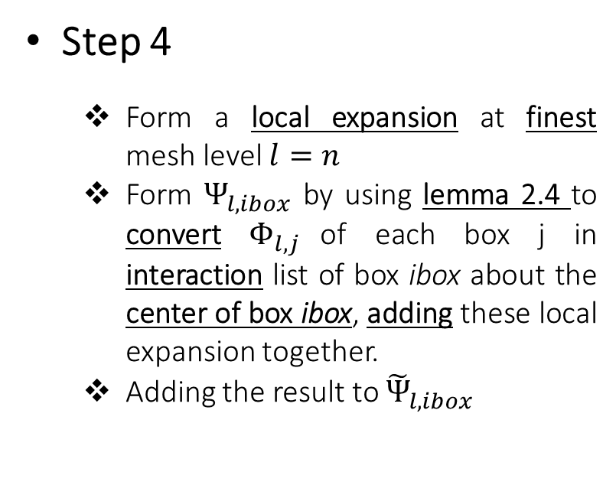
Algorithm
ibox
 |  |  |  |  |  |  | ·
 |  |  |  |  | •
 |  |  |  | • | •
Step 4
Form a local expansion at finest mesh level $l=n$
Form $Ψ_{l,ibox}$ by using lemma 2.4 to convert $Φ_{l,j}$of each box j in interaction list of box ibox about the center of box ibox, adding these local expansion together.
Adding the result to ${\tilde{Ψ}}_{l, ibox}$

Slide 20

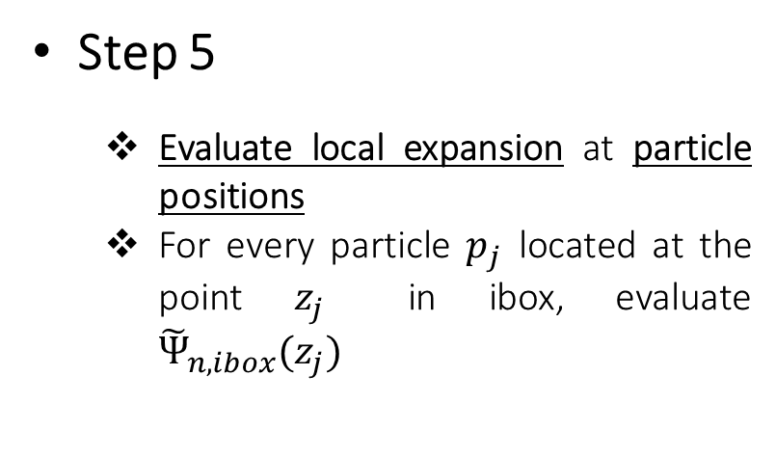
Algorithm
 |  |  |  |  | •
Step 5
Evaluate local expansion at particle positions
For every particle $p_{j}$ located at the point $z_{j}$ in ibox, evaluate ${\tilde{Ψ}}_{n, ibox}(z_{j})$
$p_{j}$
ibox

Slide 21

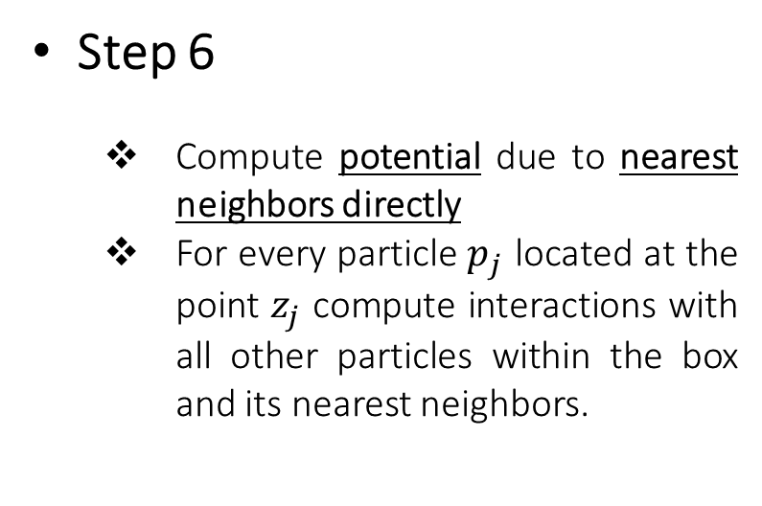
Algorithm
Step 6
Compute potential due to nearest neighbors directly
For every particle $p_{j}$ located at the point $z_{j}$ compute interactions with all other particles within the box and its nearest neighbors.
$z_{j}$
ibox

Slide 22
Algorithm
Step 7
Direct terms (nearest neighbors)
far field terms
Step 7
$z_{j}$
ibox

Slide 23
Thank you
For your attention

